Slide 1
Google Play Store app Ratings
a presentation by
Cameron Respicio
Notes:
Hi everyone. My name is Cameron, and today I am going to share with you my final capstone on the Google Play Store and how app ratings are influenced.

Slide 2
Introduction
What drives app ratings?
When are these characteristics decided on?
Who will this benefit?
Notes:
My quest was to find out if there are standalone characteristics about apps in the Play Store that have influence on how end users rate them.
When are these design decisions made? Are they made before the app goes into development? Is it possible to make decisions at the ground floor, but still have bearing on the app’s overall success? That is what I am trying to answer with my research
This is meant to benefit tech companies and app developers that primarily distribute their platforms via mobile app. They could use the results of this research to guide their decision on applications they build now or in the future.

Slide 3
About the Data
The raw data contained on 11,000 app reviews.
Wrangled and cleaned data in Python.
Isolated columns: Category, Size, Price, and Rating.
3,100 rows after removing null values.
Notes:
The raw data contained information on just shy of 11,000 rows of information. Each row was an individual app, and they housed string and float data.
Where I started was taking the data as a csv file, and importing into a Jupyter Notebook where wrangled and cleaned.
I isolated the columns that I would use to test for characteristics: App category, file size, and whether the app was free or paid, and of course the user rating.
After removing all rows with null values, I was left with just over 3,100 rows of data.

Slide 4
H1 : App Categories
Created buckets for testing.
Top 5 Rating: 4.17
Else Rating: 4.14
The difference IS NOT significant.
Notes:
Hø: There is no significant difference in the five most common app categories.
There were 33 unique app categories, so first I created two variables. One that would bucket the top 5 categories altogether, and another that grouped all categories that fell outside of the top 5.
Family, Tools, Games, Personalization, Medical
Using a function that I created to provide the average rating, I determined that at just 0.03 points, the 5 most common app categories had the higher average rating, but then it came time to test for statistical significance.
Using the .ttest_ind() function from the SciPy library, I conducted an independent two samples t-test on the average rating for both buckets and determined a p value of 0.11, which would mean that….The difference IS NOT significant at the 95% confidence level.
Using a function I created to determine the two-tail confidence intervals, I graphed this bar chart to illustrate how the error bars intersect one another.

Slide 5
H2 : App Sizes
Created buckets once more
Top 10 Average Rating: 4.19
Else Average Rating: 4.14
The difference IS NOT significant.
Notes:
Hø: There is no significant difference between the average rating of apps with the 10 most common file sizes.
413 unique app sizes, so much like with app categories, I bucketed the top 10 together in one variable and all others in another variable.
11mb, 12mb, 14mb, 15mb, 18mb, 19mb, 20mb, 21mb, 22mb, and 24mb
Using the same function that I mentioned earlier I called upon it to determine the average ratings for these app size buckets as well. At 4.19, the top 10 edged out all others by 0.05 points. But again, we must test for statistical significance.
Similarly to before, I used the .ttest_ind() function to determine the p-value of 0.102, which would again mean that….the difference IS NOT significant and we must accept the null.
Again, you will notice that the error bars for the two buckets intersect.

Slide 6
H3 : App Price
Free vs. Paid
Free: 4.14
Paid: 4.22
The difference IS significant.
Notes:
Hø: There is no significant difference in the ratings of free apps and paid apps.
There are only two values for this column, so I did not need to bucket them, however they still needed to be entered into their own variables for testing.
Using my average rating function, I found that paid apps on average were higher by 0.08 points at 4.22 than free apps. I found this discovery the least expected, yet the most interesting. I would think that paid apps are inherently subject a lower rating given the nature of my personal bias against a willingness to pay for apps. However interesting, I needed to test for statistical significance to determine if it means anything.
I determined a p-value of 0.0021, which would mean that…. The difference IS significant, and you can see this time that the error bars do not intersect.

Slide 7
What did we Learn?
Not statistically significant:
Top 5 categories at 0.03 higher
Top 10 app sizes at 0.05 higher.
Statistically significant:
Paid apps at 0.08 higher.
Notes:
The five most common app categories in Family, Tools, Games, Personalization, and Medical on average have a higher rating of 0.03, but is not statistically significant.
The ten most common app sizes in 11mb, 12mb, 14mb, 15mb, 18mb, 19mb, 20mb, 21mb, 22mb, and 24mb on average have a higher rating of 0.05, but is not statistically significant.
Paid apps on average have a higher rating than free apps by 0.08, and is statistically significant.

Slide 8
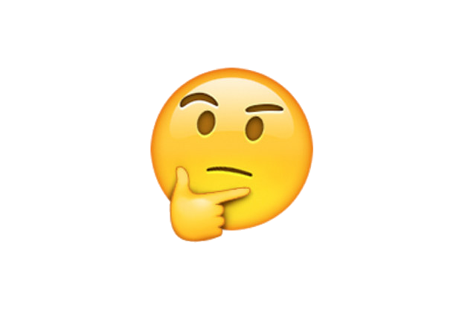
How to use this research
Notes:
Between both app categories and app sizes, there is such a vast pool of possibilities that can produce very different results. While we determined earlier on that the difference in their average ratings were not significant, they are quite small to the point where the difference is negligible anyways.
It gets interesting when we look at free and paid apps. If you walk away from here with anything today, I don’t want it to be that you should charge for apps just to charge for them. I want you to weigh your options and consider paid apps as another revenue if it makes sense for your business. If you need to charge for an app to continue development, that is fine. If the market deems a $2.99 price tag as standard, and you want to stay competitive, you go right ahead.
Because as the data suggests, users will rate paid apps just a hair higher than free apps despite requiring that initial payment.

Slide 9
Thank you

